Slide 1
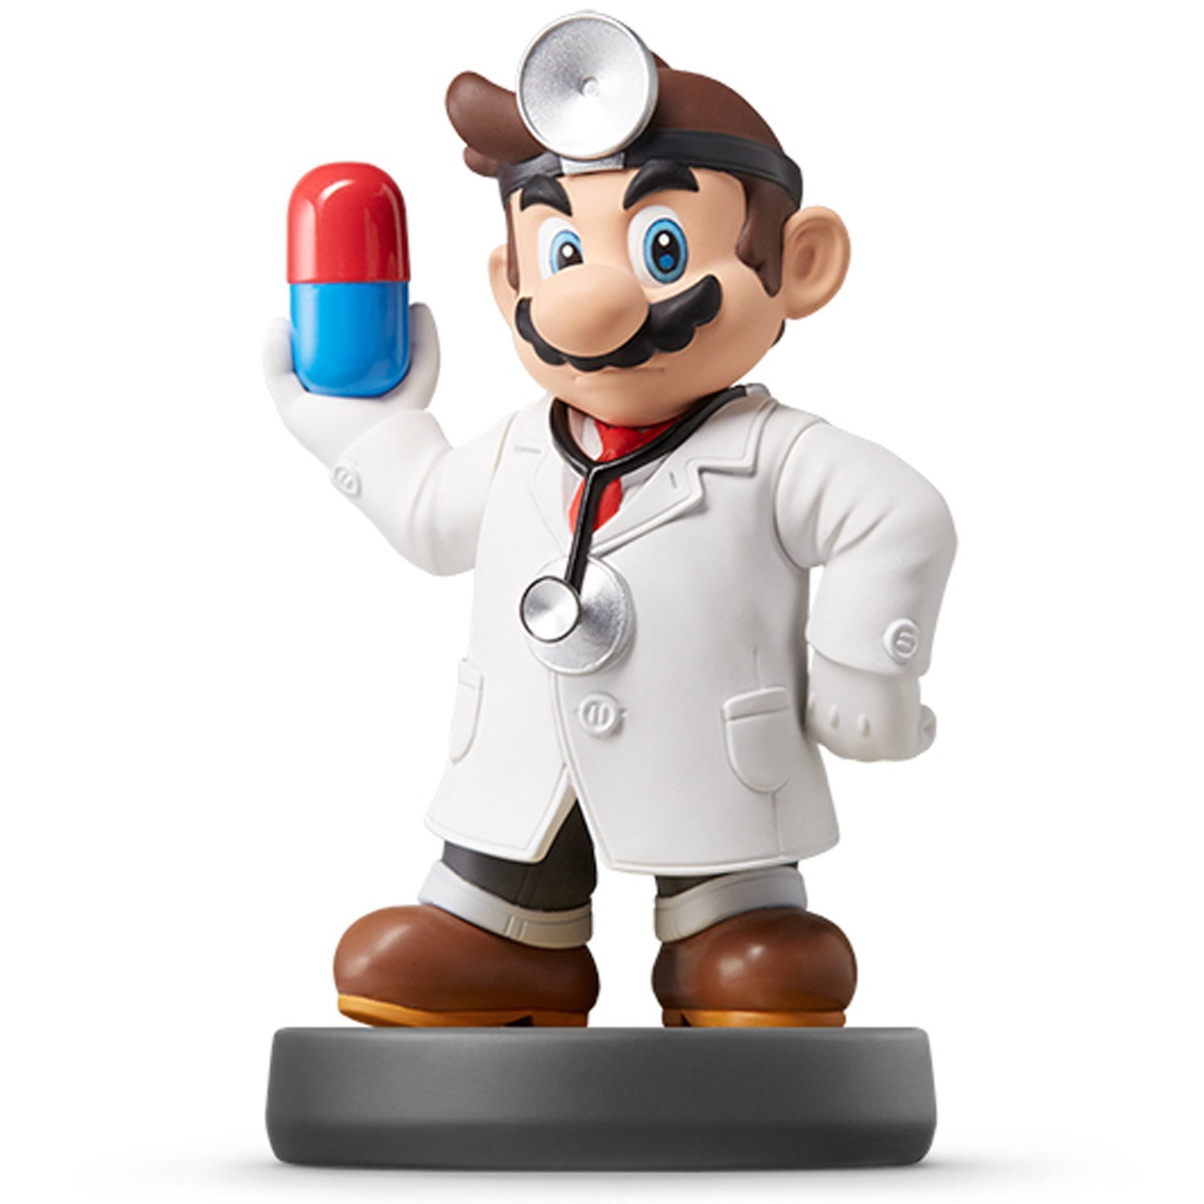
Modeling VII

Slide 2
Introduction
Non-Parametric Classification
K-Nearest Neighbors (k-NN)
Machine Learning Technique
Intuitive
Non-Parametric
Used for Predicting Classes of an Output Variable
Instructions:
Open Tutorial Rmd File
Knit the Document
Read the Introduction

Slide 3
Idea Behind k-NN
Scenario: Will a College Football Player Be Drafted Into the NFL?
Two Possible Classes
Drafted
Undrafted
Known Information
Data From All Previous Players Who Entered Draft
Whether or Not They Were Drafted
Their University and Position
Playing Statistics
Body Measurements

Slide 4
Idea Behind k-NN
Current Draft Eligible Player
Who? Mike Jones
USC and QB
Passer Rating = 95
6’4’’, 205 lbs.
Goal: Predict Whether or Not Mike Jones Will Be Drafted
Base Your Prediction for Mike Jones on the k=5 Most Similar Players From Historical Info

Slide 5
Idea Behind k-NN
Process
Consider Database of Info
Find 5 Most Similar Players
QB’s From USC
Similar Passer Ratings
Similar Body Types
Of the 5, Observe Classes
4 Drafted
1 Undrafted
Above Info Acts as Votes
Historical Information Leads Us to Conclude Mike Jones is More Likely to Be Drafted
Predict Mike Jones Will Be Drafted into the NFL

Slide 6
k-NN Algorithm
Step 1: Choose a k
Step 2: Select the k Most Similar Observations in a Database Which are the “Closest” According to the Input Variables
Step 3: Find the Most Common Classification Among These
Step 4: Classify the New Observation Based on What is Category is Known to Occur Most

Slide 7
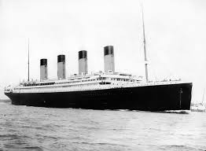
Pause For Lyrics
Love can touch us one time And last for a lifetime And never let go till we're gone

Slide 8
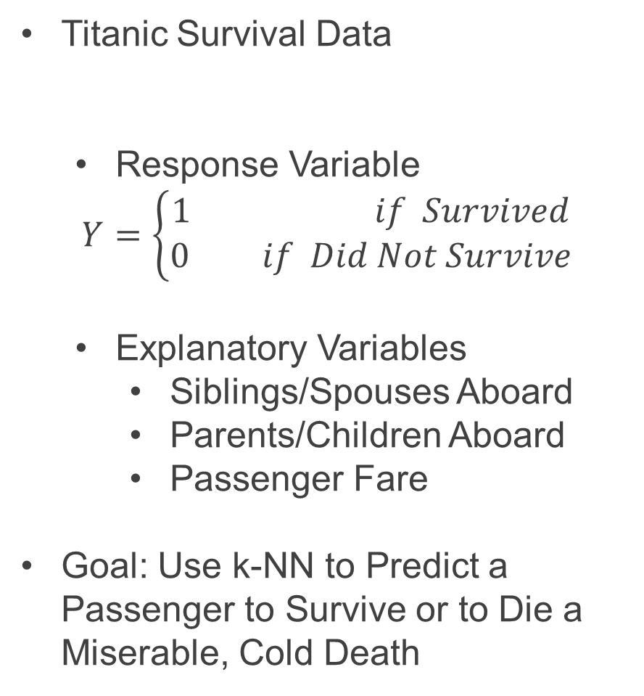
Part 1: Feature Engineering and Visualization
Titanic Survival Data
Response Variable
$$Y=\left\{\begin{aligned}1 if Survived \\ 0 if Did Not Survive\end{aligned}\right.$$
Explanatory Variables
Siblings/Spouses Aboard
Parents/Children Aboard
Passenger Fare
Goal: Use k-NN to Predict a Passenger to Survive or to Die a Miserable, Cold Death
> library(titanic)

Slide 9
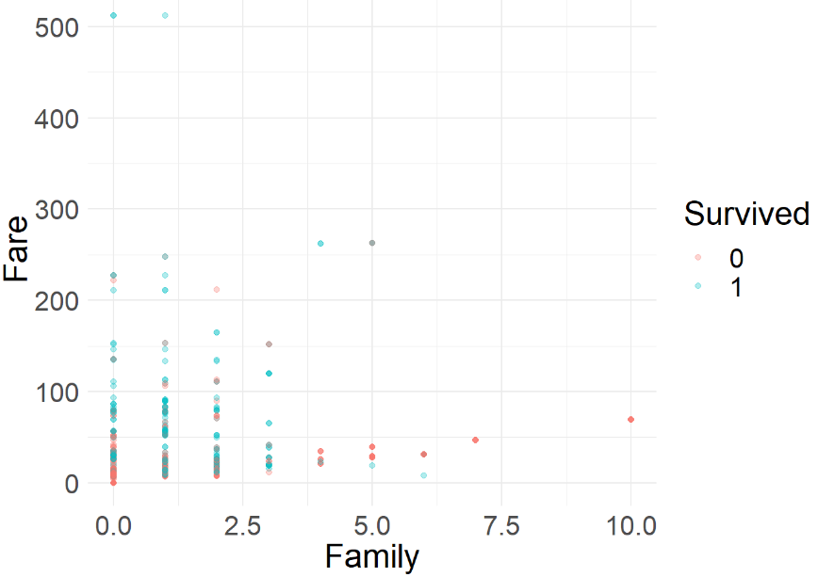
Part 1: Feature Engineering and Visualization
Run Chunk 1
Creating a New Variable
What Does This Variable Represent?
Run Chunk 2

Slide 10
Pause For Lyrics
Love was when I loved you One true time I hold to In my life we'll always go on

Slide 11
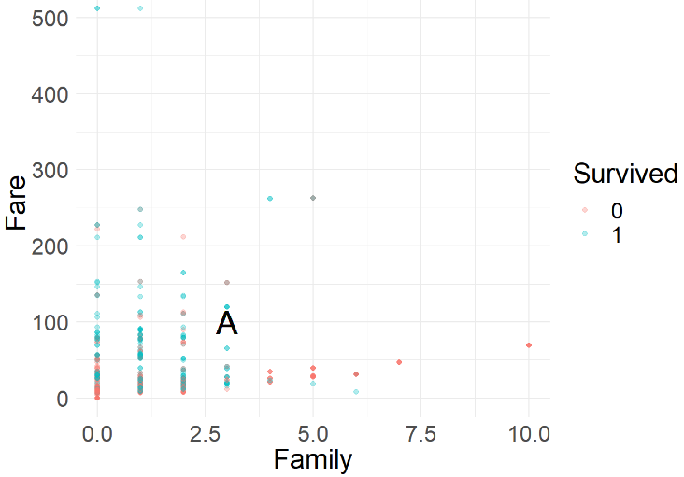
Part 2: Obtaining Predictions Using k-NN
New Individual: Alice
Had 3 Family Members on Ship
Spent $100 on Ticket
Survived or Died?
Run Chunk 1

Slide 12
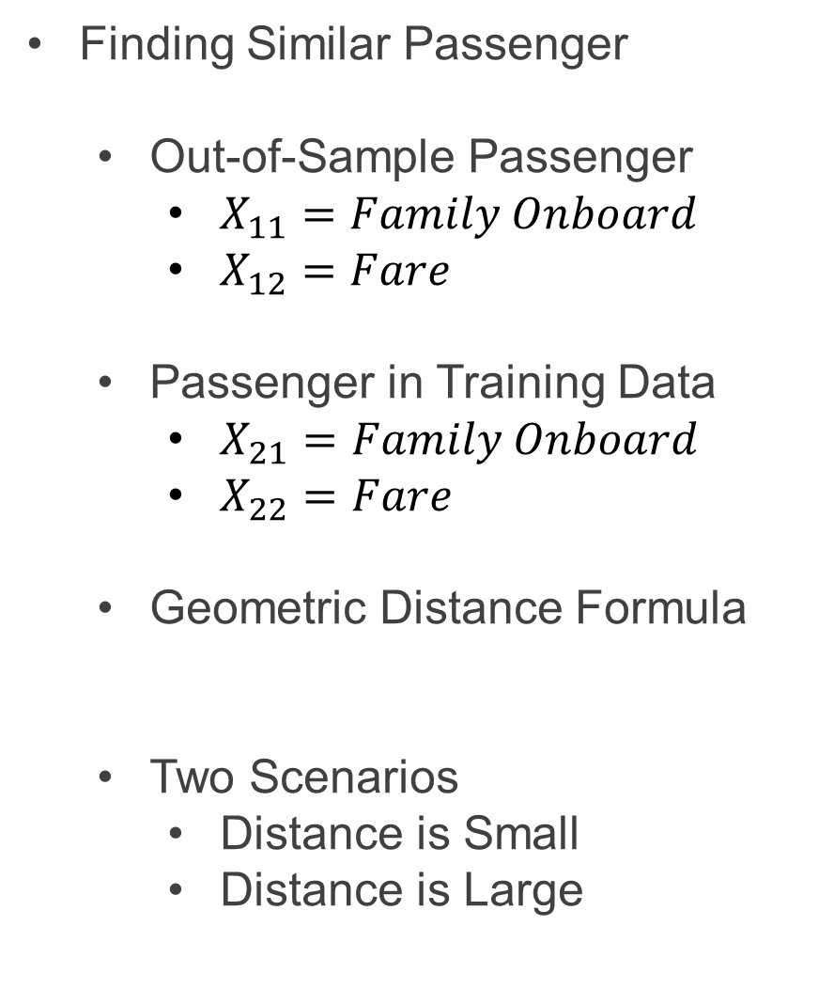
Part 2: Obtaining Predictions Using k-NN
Finding Similar Passenger
Out-of-Sample Passenger
$X_{11}=Family Onboard$
$X_{12}=Fare$
Passenger in Training Data
$X_{21}=Family Onboard$
$X_{22}=Fare$
Geometric Distance Formula
Two Scenarios
Distance is Small
Distance is Large
$$d=\sqrt{{\left(x_{11}−x_{21}\right)}^{2}+{\left(x_{12}−x_{22}\right)}^{2}}$$

Slide 13
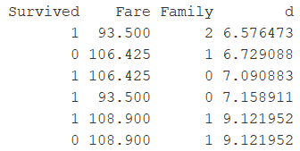
Part 2: Obtaining Predictions Using k-NN
Run Chunk 2
Suppose k=5
Five Most Similar Passengers
Why are There Six?
Did Alice Survive or Die?

Slide 14
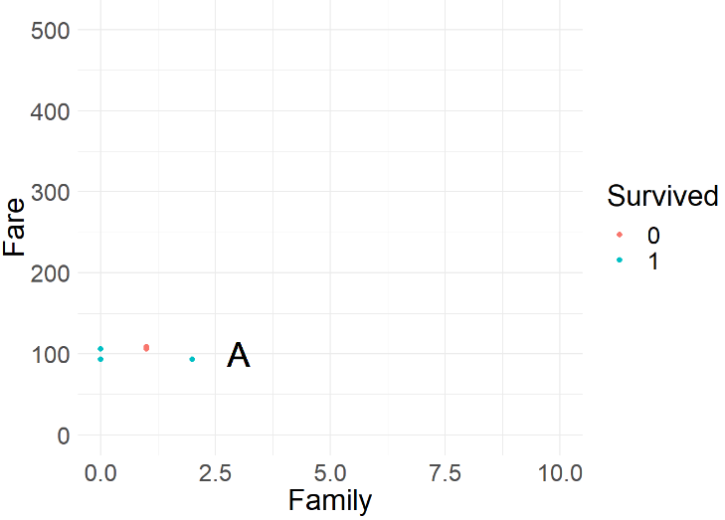
Part 2: Obtaining Predictions Using k-NN
Run Chunk 3
Output Figure
What Did You Expect to See?
Are You Surprised?

Slide 15
Pause For Lyrics
Near, far, wherever you are I believe that the heart does go on Once more you open the door And you're here in my heart And my heart will go on and on

Slide 16
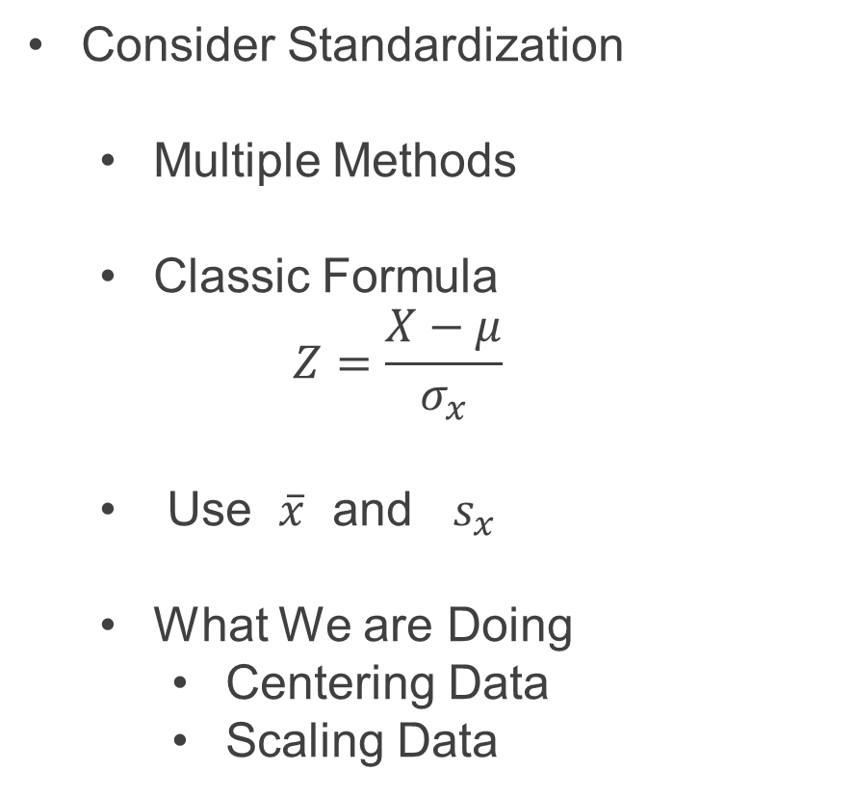
Part 3: Transform and Revisit k-NN
Consider Standardization
Multiple Methods
Classic Formula
$$Z=\frac{X−μ}{σ_{x}}$$
Use $\overline{x}$ and $s_{x}$
What We are Doing
Centering Data
Scaling Data
> scale(x,center=T,scale=T)

Slide 17
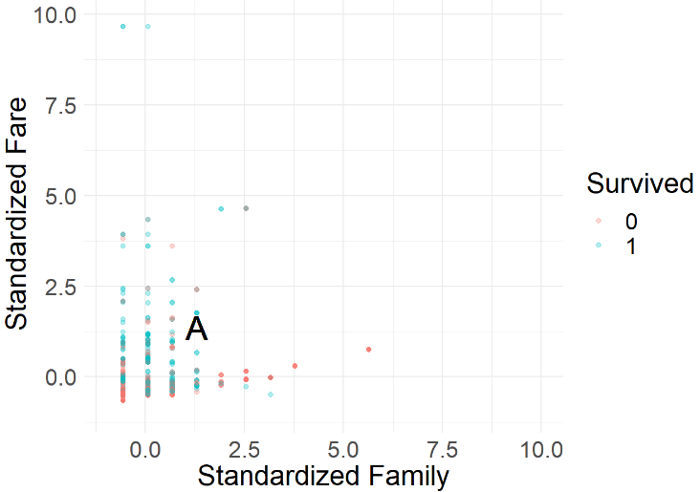
Part 3: Transform and Revisit k-NN
Run Chunk 1
Units: Standard Deviations
Alice: Above Average Family Size and Fare
Highly Skewed: Majority of Data

Slide 18
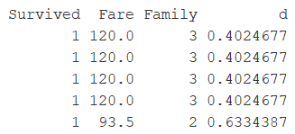
Part 3: Transform and Revisit k-NN
Run Chunk 2
Recall: Alice
Family Size of 3
$100 Ticket
Before & After Standardization

Slide 19
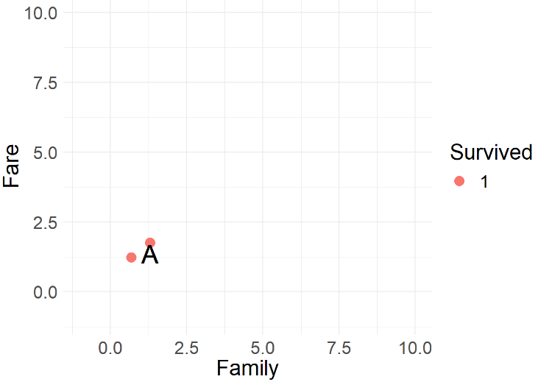
Part 3: Transform and Revisit k-NN
Chunk 2 Continued
Both Before and After Standardization We Would Predict Alice to Survive
Updated Figure

Slide 20
Pause For Lyrics
You're here, there's nothing I fear And I know that my heart will go on

Slide 21
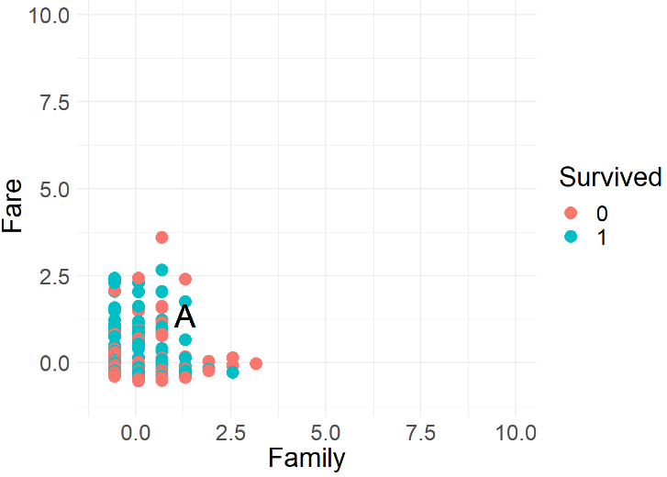
Part 4: Tuning k for k-NN
Run Chunk 1
Suppose k is Large (k=500)

Slide 22
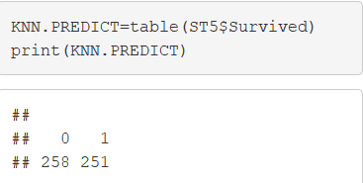
Part 4: Tuning k for k-NN
Chunk 1 Continued
Votes From Neighbors
Based on k-NN When k=500
258 Neighbors Died
251 Neighbors Survived
Predict Alice is Food for Fish

Slide 23
Part 4: Tuning k for k-NN
Leave-on-Out Cross Validation
Helpful Package for k-NN
Install the R Package
Helpful Functions
Peforming k-NN
LOOCV
For Other Important Arguments, See Documentation
> library(class)
> knn(train, test, cl, k = 1)
> knn.cv(train, cl, k = 1)

Slide 24
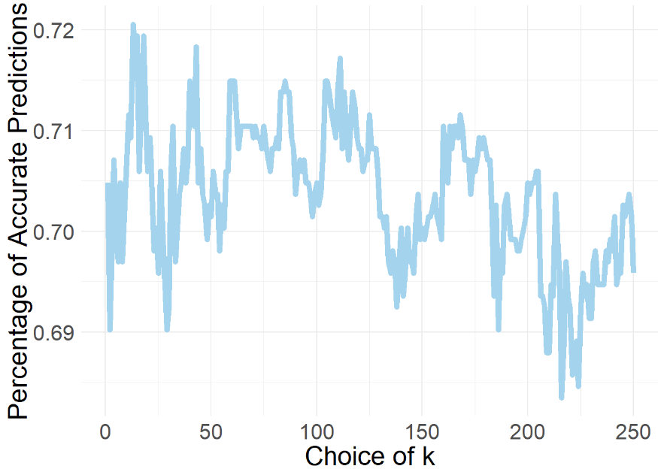
Part 4: Tuning k for k-NN
Run Chunk 2
Consider k=1,2,3,…,250
Use CV, to Generate Out-of-Sample Predictions for Each k
Calculate Overall Accuracy Percentage

Slide 25
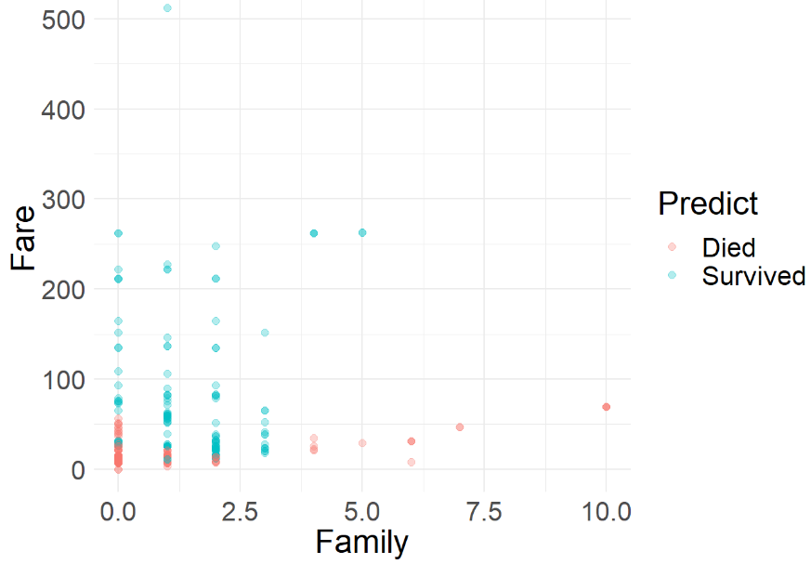
Part 4: Tuning k for k-NN
Run Chunk 3
Identify Best Choice for k (k=18)
Use k to Generate Predictions on Future Data With Unknown Survival
Figure Illustrating Predictions on Test Set for Competition
> titanic_test

Slide 26
Pause For Lyrics
We'll stay forever this way You are safe in my heart and My heart will go on and on

Slide 27

In Memoriam
Jack Dawson
Unknown – 1912

Slide 28
Closing
Disperse and Make Reasonable Decisions

